Slide 1
Sam Reid, Ph.D.
University of Colorado Boulder

Slide 2
PhET Interactive Simulations
Founded in 2002 by Boulder’s Nobel Prize Physicist Carl Wieman
120+ interactive simulations in Flash, Flex, Java, JavaScript
Free and Open Source, no login/account required to use
200,000,000 launches
Math, Physics, Biology, Earth Science, Chemistry, etc.
Highly interactive, gamelike simulations
Student = Scientist

Slide 3
Sim Demos
Energy Skate Park: Basics
Open-ended, flexible, fun
http://phet.colorado.edu/en/simulation/energy-skate-park-basics
Molecule Shapes
Visually engaging, scientifically accurate
http://phet.colorado.edu/sims/html/molecule-shapes/latest/molecule-shapes_en.html
Build an Atom
Games
http://phet.colorado.edu/sims/html/build-an-atom/latest/build-an-atom_en.html
Bending Light
http://www.colorado.edu/physics/phet/dev/html/bending-light/1.0.0-dev.8/bending-light_en.html

Slide 4
Process
Idea (from teachers, community, etc.)
Design + Implement
Student interviews
Code review
Thorough QA Testing on 18 platforms
Publish
Maintenance

Slide 5
Implementation
The simulation
Model support: Axon
View support
Scene graph, input events, rendering: Scenery
User interface components (checkboxes, sliders, etc): Sun
Custom interface (water faucets, gauges): Scenery-phet
Framework: Joist
Build tools: Chipper
Builds a single HTML file (inlines all images/audio)
One http request
Easy for teachers to download and run, no server necessary

Slide 6
The Scene Graph: Scenery
Configurable hit areas for touch devices
http://phet.colorado.edu/sims/html/beers-law-lab/latest/beers-law-lab_en.html?showPointerAreas
Render with SVG/Canvas/WebGL (partial support)
http://localhost:8080/acid-base-solutions/acid-base-solutions_en.html?ea&brand=phet&rootRenderer=canvas&screens=1
var node = new ProtractorNode({renderer:’canvas’});
Excellent performance all the way back to iPad2
Fine control over the UI presentation on every platform
Fuzz testing: http://localhost:8080/acid-base-solutions/acid-base-solutions_en.html?fuzzMouse
Screen capture: http://localhost:8080/wave-on-a-string/wave-on-a-string_en.html?ea&brand=phet&screenshot

Slide 7
Internationalization
Balancing Act: Arabic:
http://localhost:8080/balancing-act/balancing-act_en.html?ea&brand=phet&locale=ar
Under Pressure: Japanese:
http://localhost:8080/under-pressure/under-pressure_en.html?ea&brand=phet&locale=ja
Build an Area: Double
http://localhost:8080/area-builder/area-builder_en.html?ea&brand=phet&stringTest=double
String test:
http://localhost:8080/acid-base-solutions/acid-base-solutions_en.html?stringTest=Thanks Quick Left!

Slide 8
Accessibility
http://phet.colorado.edu/en/about/accessibility
Forces and Motion: Basics
http://www.colorado.edu/physics/phet/dev/html/forces-and-motion-basics/1.1.5-dev.4/forces-and-motion-basics_en.html?screens=1
Faraday’s Law
http://www.colorado.edu/physics/phet/dev/html/faradays-law/1.0.1-sonification.8/faradays-law_en.html

Slide 9
Interoperability
Beaker sim
Remove controls
http://localhost/beaker_en.html?ea&together.values=%7B"beaker.beakerScreen.soluteSelector.visible":false
Change layout
"beaker.beakerScreen.soluteSelector.rotation":1.58
Mirror
Chart
Data

Slide 10
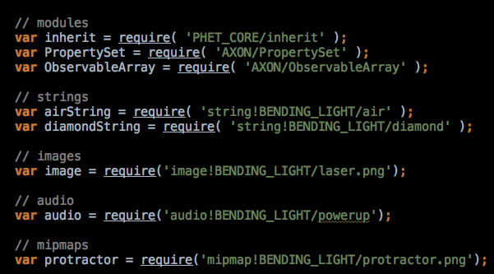
RequireJS plugins

Slide 11
Example Sim – implementation details
http://localhost:8080/example-sim/example-sim_en.html?ea&brand=phet
Code examples in IDEA

Slide 12
Kick the tires
http://phet.colorado.edu
https://github.com/phetsims/
https://twitter.com/phetsims
http://bit.ly/phet-development-overview
reids@colorado.edu
https://twitter.com/sam6reid

Slide 13
Questions?

